Slide 1
Rocket challenge
Make it go higher

Slide 2
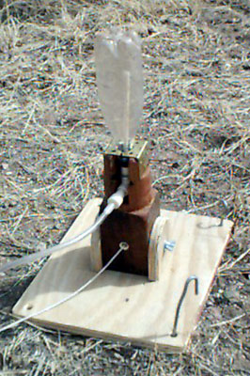
What are we working with?
PET bottles with standard caps
Launch equipment, altitude-measuring equipment, water
Paper, cardboard, cut-up bottles, tape, glue etc.

Slide 3
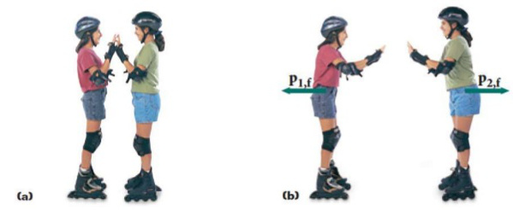
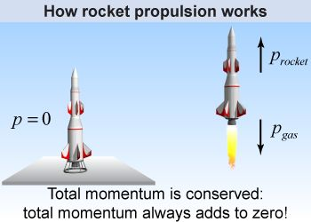
How do rockets work anyway?
By conservation of momentum
(momentum in = momentum out)
p = momentum = mass x velocity

Slide 4
What can we study?
Bottle size
How much water? ( 1/2 full? ¼? No water? )
Pressure. (default is 60 psi = 4 atmosphere)
Empty weight (as light as possible? Add some dead weight? Front or back?)
Shape (round nose, pointy? Wings, fins, 2,3,4? where to put them?
Remember: only pick one variable to change

Slide 5
Go outside, launch, measure
Bring your rocket(s)
Sunscreen and hats, water
How many launches does yout team need?
Bring spare parts, tools?
Write everything down!

Slide 6
The report
Clear story, beginning to end.
What was the plan, and what did you expect to happen?
What were the measurements, and other field observations
Conclusion
If you had another go at this, would you do anything differently?

